Slide 1

Branch - CSE Python Programming
Lecture – 17 Lists – Part 2
By
Dr. Smita Tiwari
Assistant Professor
Department of Computer Science and Engineering
School of Engineering & Technology

Slide 2
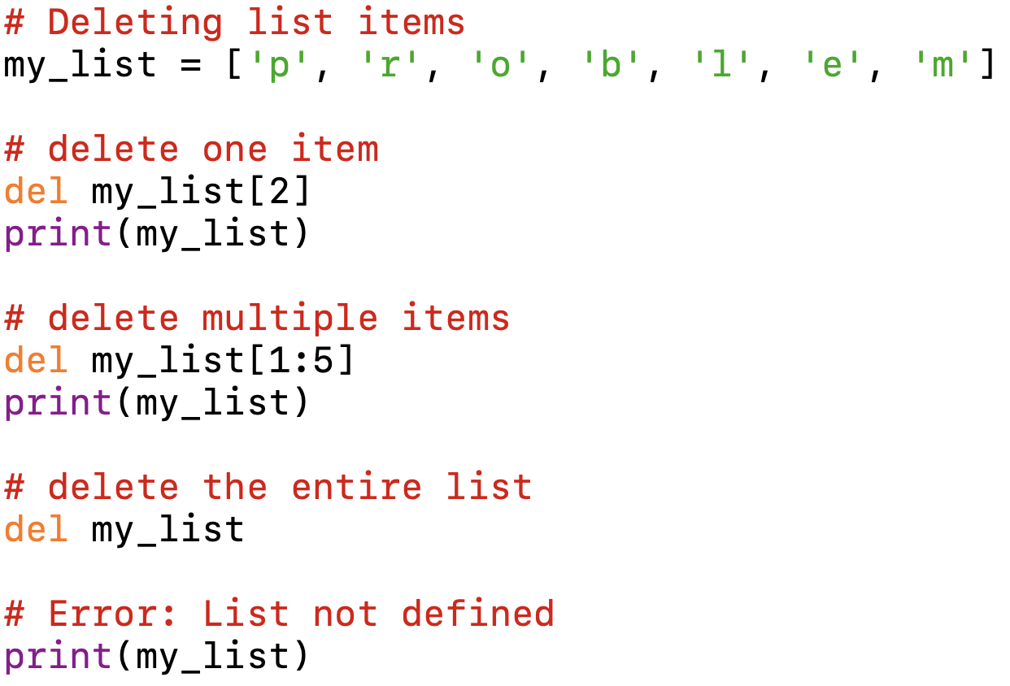
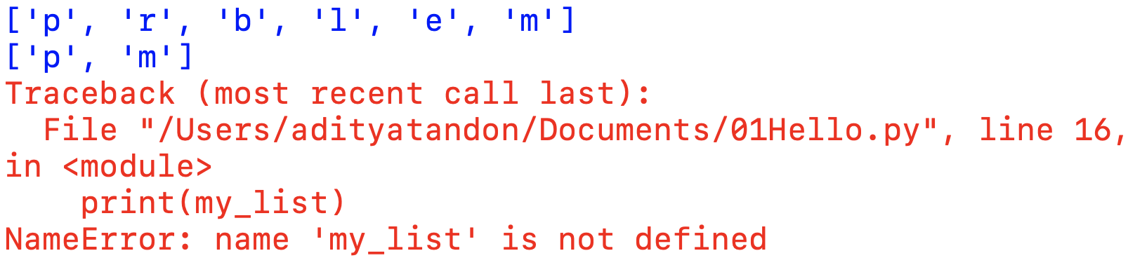
Delete List Elements
We can delete one or more items from a list using the del statement (which we discussed in Lecture 11 – Strings – Part 1).
Output:

Slide 3
Delete List Elements
We can use remove() to remove the given item or pop() to remove an item at the given index.
The pop() method removes and returns the last item if the index is not provided.
This helps us implement lists as stacks (first in, last out data structures).
And, if we have to empty the whole list, we can use the clear() method.

Slide 4
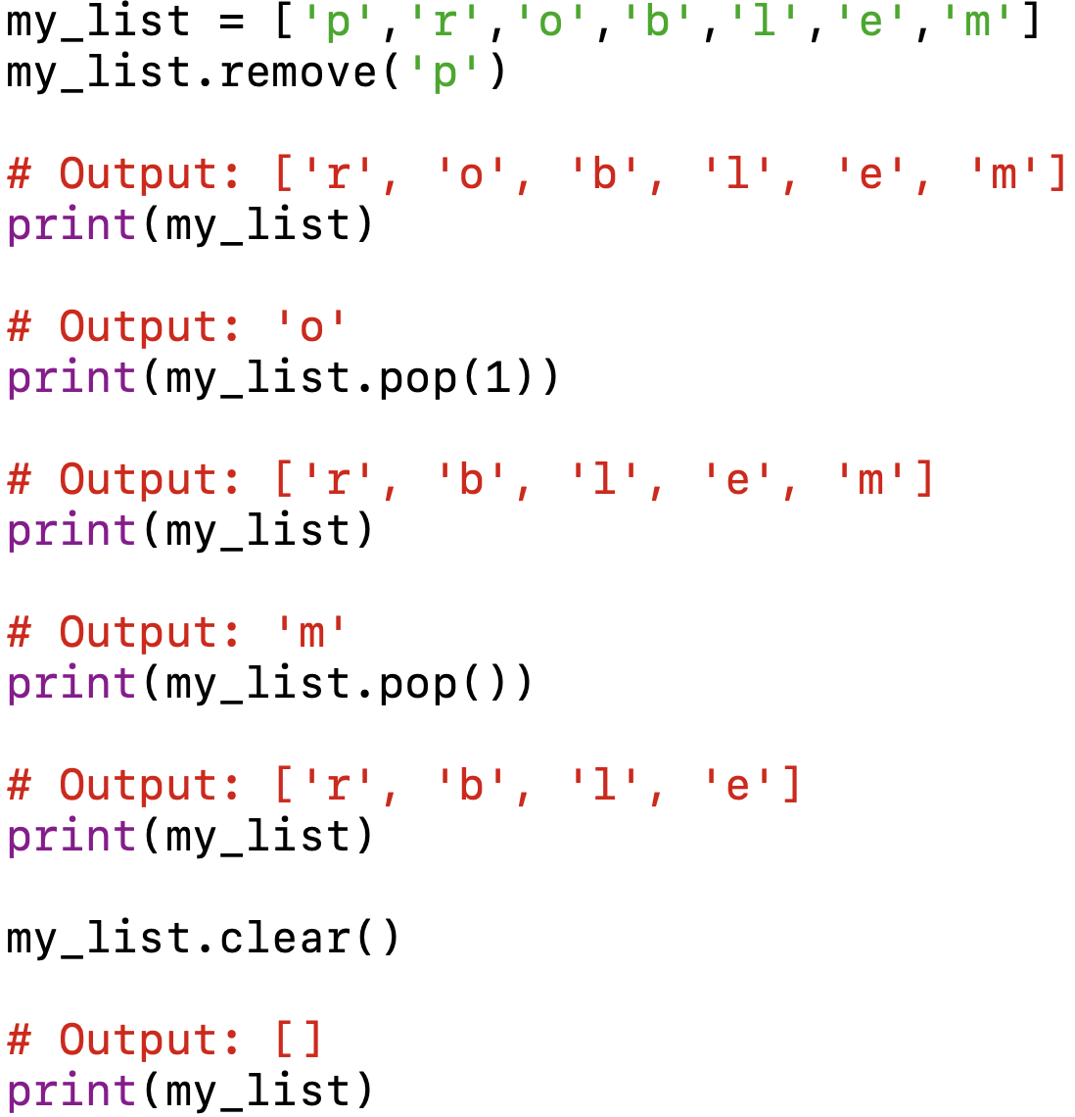
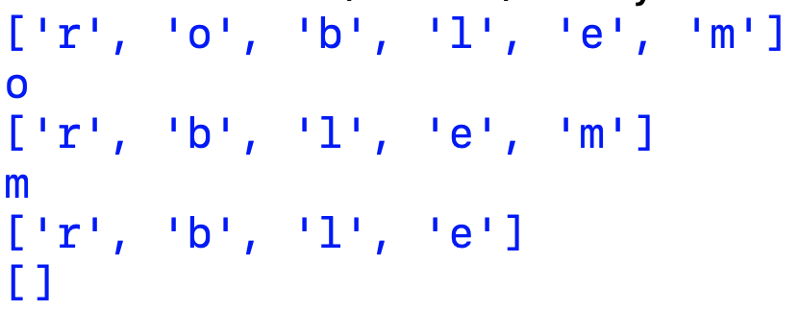
Output:

Slide 5
Python List Methods
Methods | Descriptions
append() | adds an element to the end of the list
extend() | adds all elements of a list to another list
insert() | inserts an item at the defined index
remove() | removes an item from the list
pop() | returns and removes an element at the given index
clear() | removes all items from the list
index() | returns the index of the first matched item
count() | returns the count of the no. of items passed as an argument
sort() | sort items in a list in ascending order
reverse() | reverse the order of items in the list
copy() | returns a shallow copy of the list

Slide 6
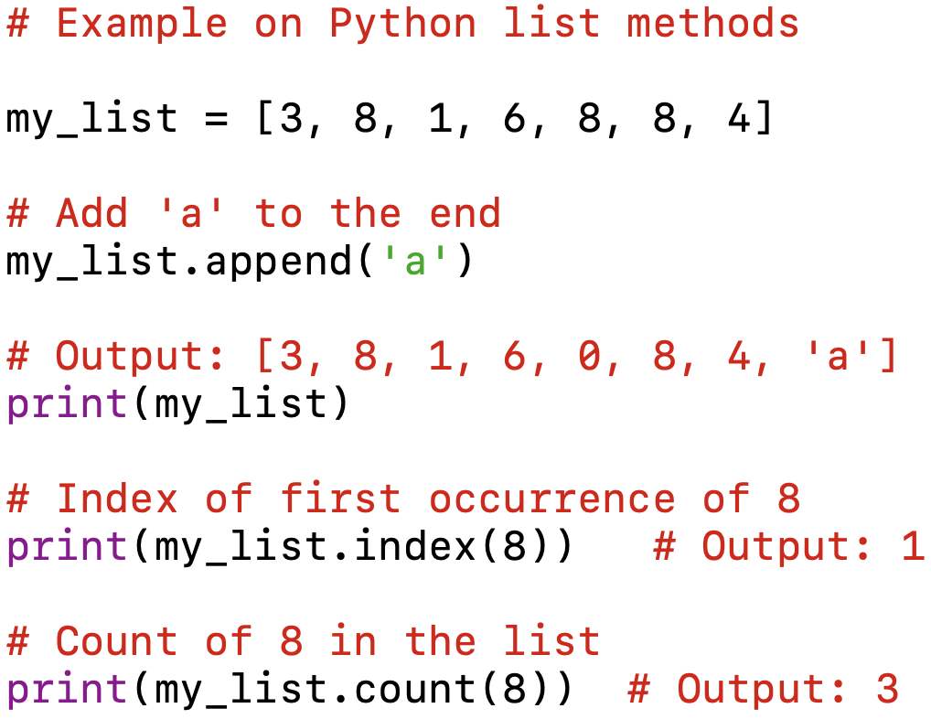
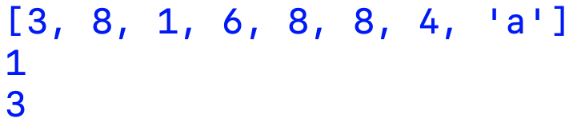
Python List Methods
Output:

Slide 7
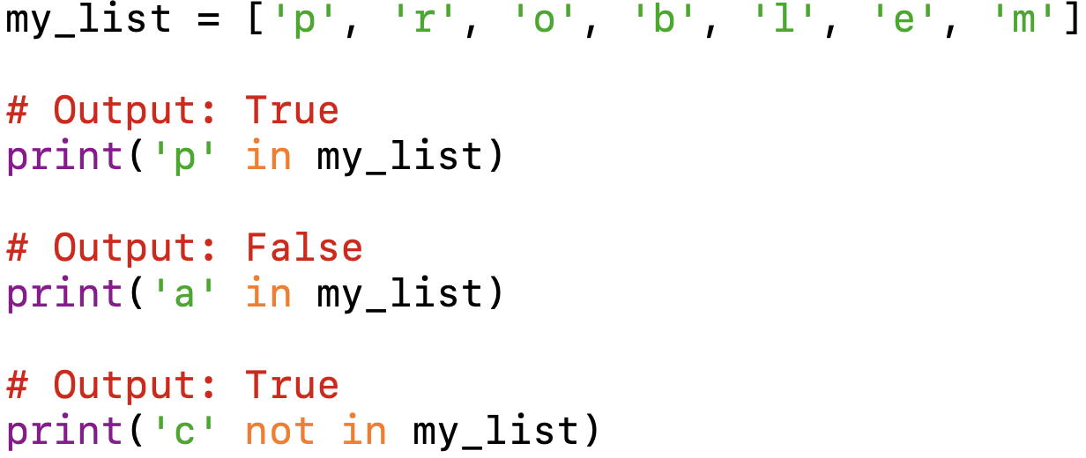
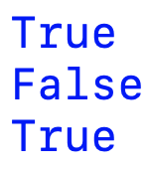
Other List Operations in Python
List Membership Test
Output:

Slide 8
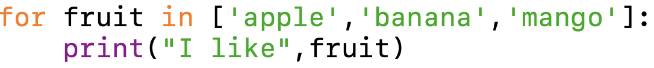
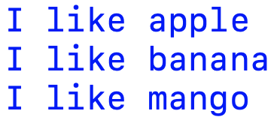
Iterating Through a List
Using a for loop we can iterate through each item in a list.
Output:

Slide 9
4 Amazing Things You Can Do With Lists
Retrieving a certain portion of a list
Perform similar operation on every element of the list
Reversing a list
Iterating over multiple lists simultaneously

Slide 10
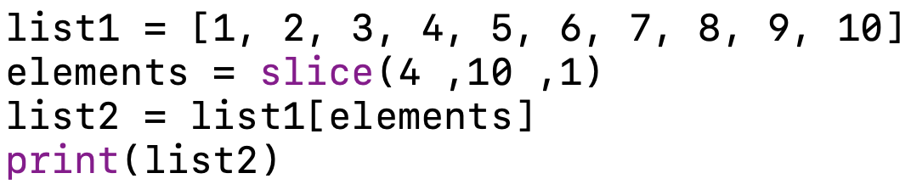

Retrieving a certain portion of a list
We might want to retrieve a certain portion of a list and make a new list out of it. We can achieve this using the slice() method.
It takes starting index value, ending index value and the increment order.
Just like the range() method
Output:

Slide 11
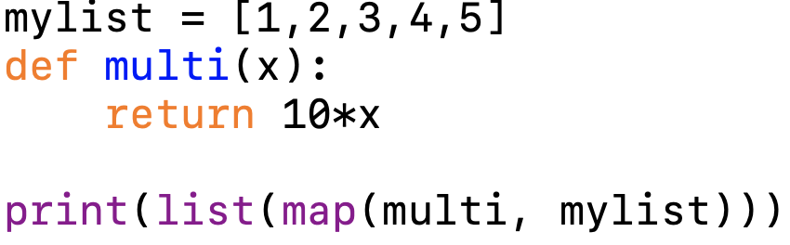

Perform similar operation on every element of the list
If you want to perform a set of operations on every element of a list, you can do this using the map() function.
You only need to write your function including those operations and then use the map() function which takes a function and an iterable (list in this case).
Output:

Slide 12
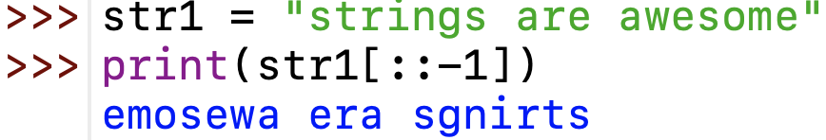
Reversing a list
It is common trick that is known to almost all Python programmers, but it is worth starting with. In this case, we use the [ ] operator to traverse through a list in the reverse direction by setting the third parameter to -1.

Slide 13
Iterating over multiple lists simultaneously
You have two lists whose elements you want to access simultaneously.
The zip() function allows you to do that using one line of code.
This function takes multiple lists as the arguments and iterates through them at the same time.
The iteration stops when the smaller list is exhausted.
The best part about the zip function is that it can be used to iterate through multiple lists at the same time.

Slide 14
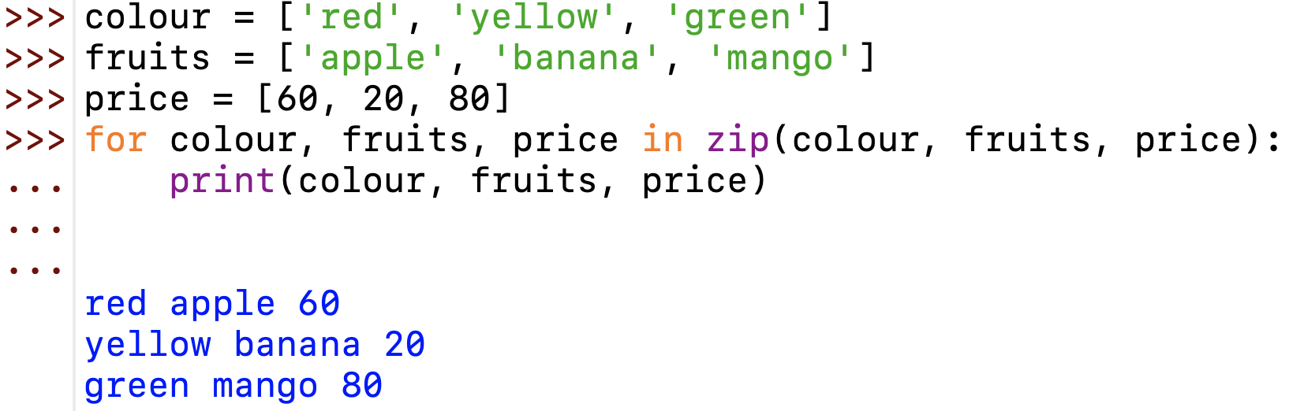
Iterating over multiple lists simultaneously

Slide 15
THANK YOU

